Slide 1
Descriptive Statistics
Santosh Chhatkuli

Slide 2
After data is presented in the tables and charts, the next step in the statistical analysis is to summarize the data numerically.
Summary Measures of Numerical Data
Central value: Central value of data set
Arithmetic Mean, Geometric Mean, Harmonic Mean, Mode, Median, Mid-range
2. Partition Values: Cutoff points
Quartiles, Deciles and Percentiles
Spread: Scatterness or variability of data
Range, Inter-fractile Range, Mean Deviation, Standard Deviation, Variance, Coefficient of Standard Deviation
4. Skewness: Shape of the distribution
5. Kurtosis: Size of the distribution
Summary Measures of Categorical Data
Ratios
Proportions
Rates
Percentages
Coefficients

Slide 3
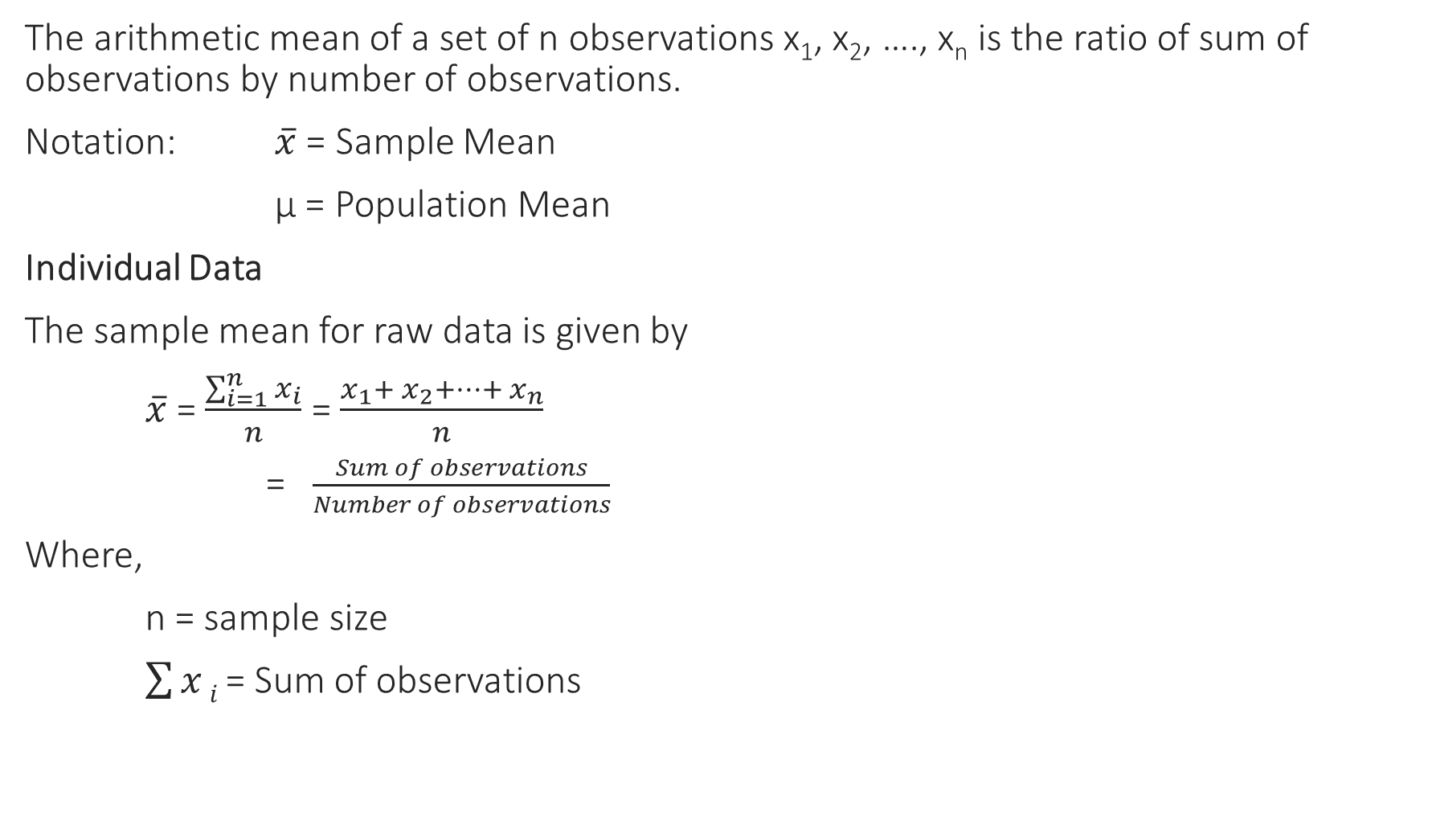
Arithmetic Mean
The arithmetic mean of a set of n observations x₁, x₂, …., x_{n} is the ratio of sum of observations by number of observations.
Notation: $\overline{x}$ = Sample Mean
µ = Population Mean
Individual Data
The sample mean for raw data is given by
$\overline{x}$ = $\frac{\sum_{i=1}^{n}{x_{i}}}{n}$ = $\frac{x_{1}+ x_{2}+…+ x_{n}}{n}$
= $\frac{Sum of observations}{Number of observations}$
Where,
n = sample size
$\sum{x}i$ = Sum of observations

Slide 4
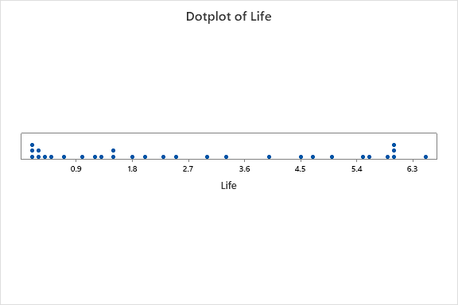
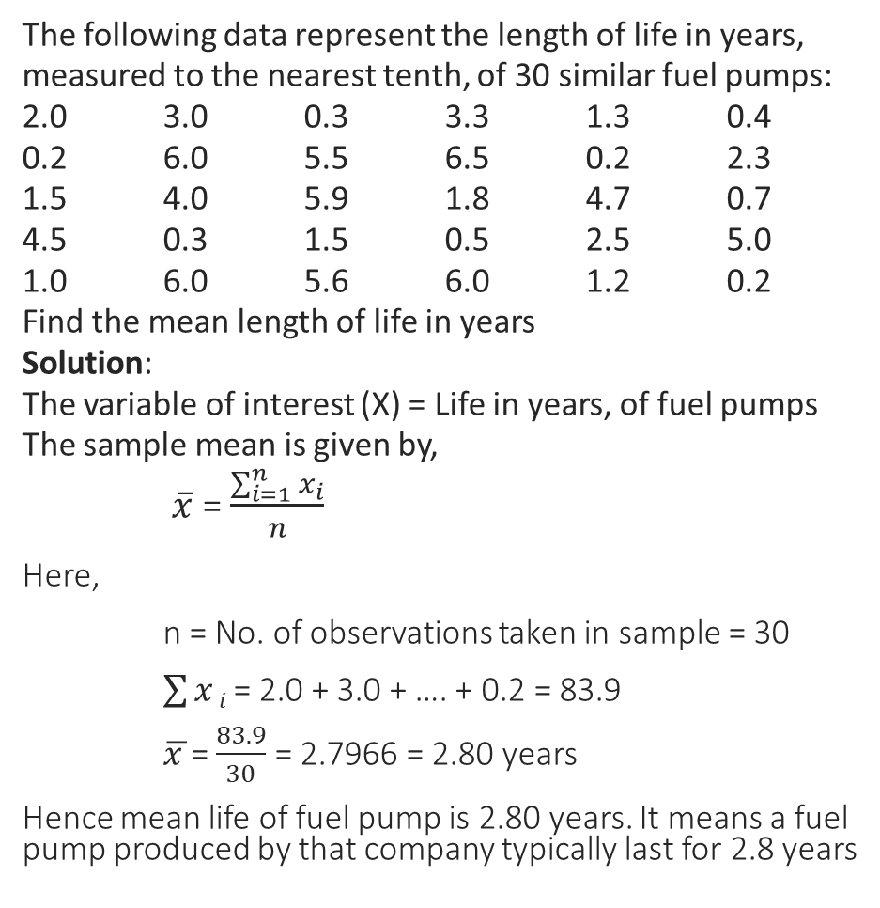
Numerical Example
The following data represent the length of life in years, measured to the nearest tenth, of 30 similar fuel pumps:
2.0 3.0 0.3 3.3 1.3 0.4
0.2 6.0 5.5 6.5 0.2 2.3
1.5 4.0 5.9 1.8 4.7 0.7
4.5 0.3 1.5 0.5 2.5 5.0
1.0 6.0 5.6 6.0 1.2 0.2
Find the mean length of life in years
Solution:
The variable of interest (X) = Life in years, of fuel pumps
The sample mean is given by,
$\overline{x}$ = $\frac{\sum_{i=1}^{n}{x_{i}}}{n}$
Here,
n = No. of observations taken in sample = 30
$\sum{x}i$ = 2.0 + 3.0 + …. + 0.2 = 83.9
$\overline{x }$= $\frac{83.9}{30}$ = 2.7966 = 2.80 years
Hence mean life of fuel pump is 2.80 years. It means a fuel pump produced by that company typically last for 2.8 years
Dot plot

Slide 5
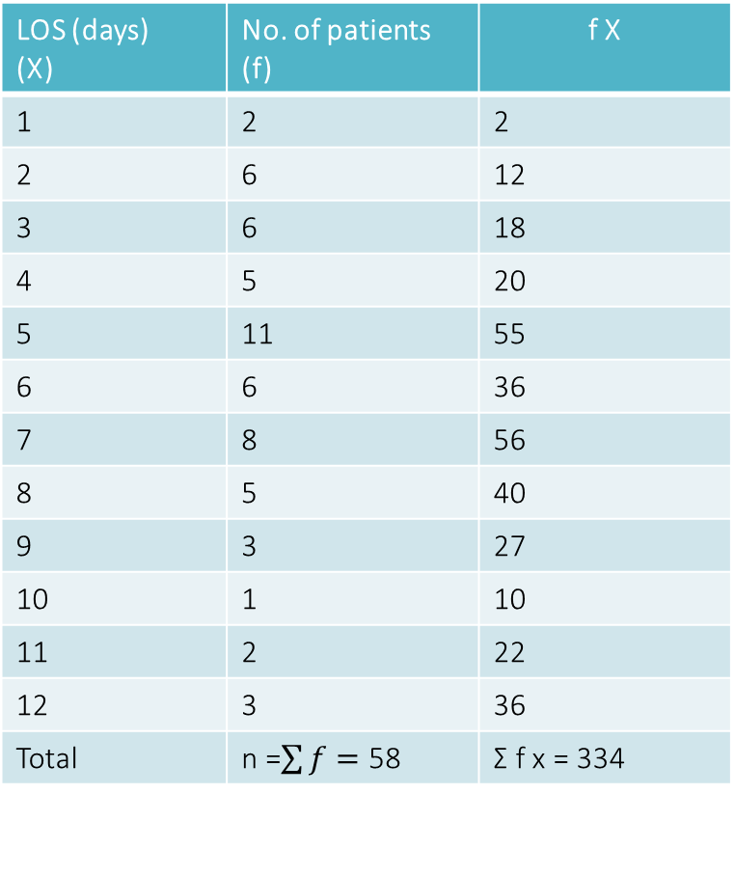
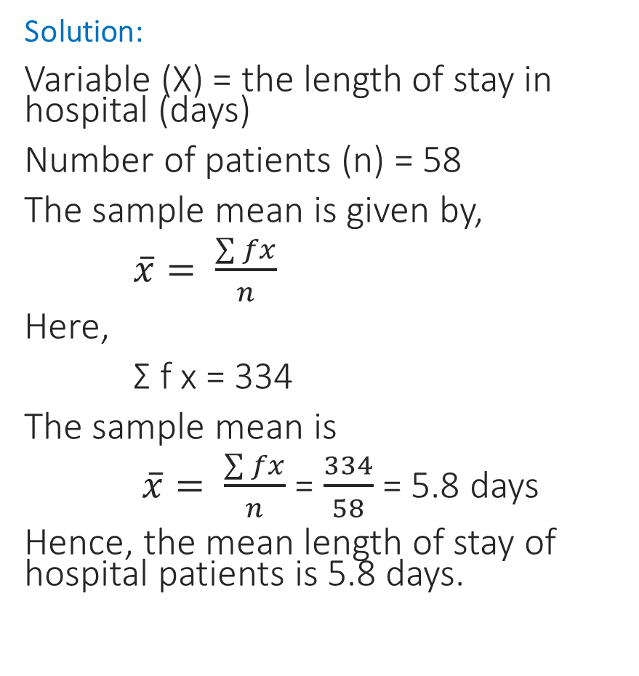
Computing arithmetic mean in frequency distribution
The length of stay of hospital patients is given in the following table. Find the mean LOS of patient.
Solution:
Variable (X) = the length of stay in hospital (days)
Number of patients (n) = 58
The sample mean is given by,
$\overline{x}= \frac{\sum{fx}}{n}$
Here,
Σ f x = 334
The sample mean is
$\overline{x}= \frac{\sum{fx}}{n}$ = $\frac{334}{58}$ = 5.8 days
Hence, the mean length of stay of hospital patients is 5.8 days.
LOS (days) (X) | No. of patients (f) | f X
1 | 2 | 2
2 | 6 | 12
3 | 6 | 18
4 | 5 | 20
5 | 11 | 55
6 | 6 | 36
7 | 8 | 56
8 | 5 | 40
9 | 3 | 27
10 | 1 | 10
11 | 2 | 22
12 | 3 | 36
Total | n =$\sum{f}=$ 58 | Σ f x = 334

Slide 6
The grades of students in Statistics paper is given below
Find the mean grade of students.
Solution:
The variable of interest (X ) = grades of students in Stat paper
Size of the sample (n) = 80
The sample mean in the grouped frequency distribution is given by,
Grade | No. of students
52 – 58 | 2
58 – 64 | 12
64 – 70 | 10
70 – 76 | 19
76 – 82 | 16
82 – 88 | 9
88 – 94 | 7
94 – 100 | 5
Total | 80

Slide 7
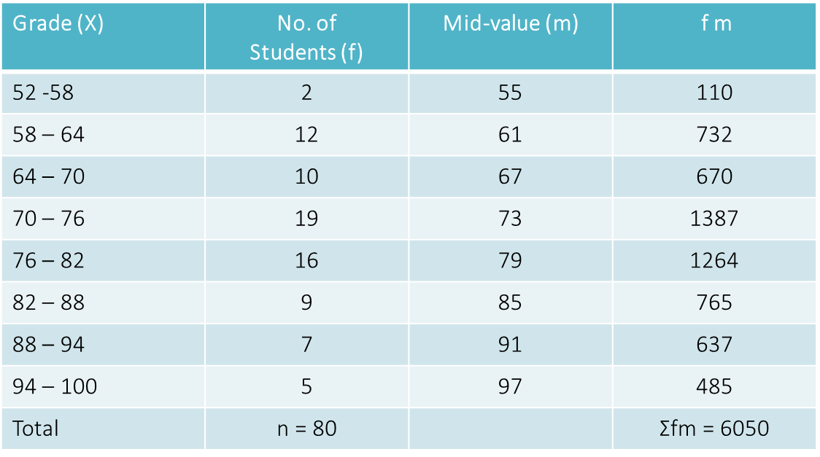

The sample mean is given by,
$\overline{x}=\frac{\sum{fm}}{n}$
Where,
m = mid-value of the class
Now, the sample mean is given by,
$\overline{x}=\frac{\sum{fm}}{n}$ = $\frac{6050}{80}$ = 75.625
Hence, the mean grade of student in Statistics paper is 75.6, which is quiet high.

Slide 8

Combined Mean
Problem: Suppose you were running a survey on reading speed, as measured by how long it took 1st graders to read a given block of text. Your results come in for five schools:
What is the pooled men of all school taken together?
Solution:
The combined mean is given by,
Sometime we need to compute the overall mean or grand mean of two or more samples pooled as a single set for some statistical processes.
School ID | Number of students | Average Reading Time
1 | 189 | 83
2 | 46 | 121
3 | 89 | 82
4 | 50 | 147
5 | 12 | 60
$${\overline{X}}_{combined}=\frac{189 x 83+46 x 121+89 x 82+50 x 1 47+12 x 60}{189+46+89+50+12}=91.06$$

Slide 9

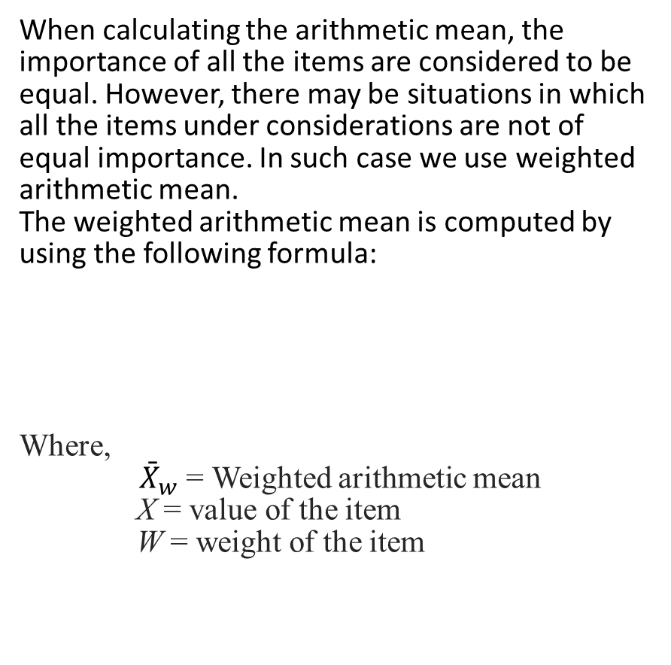
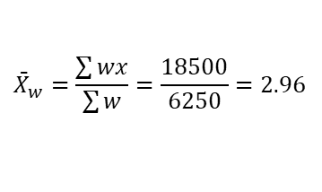
Weighted AM
Problem:
The following is the sample of five purchases of a raw material over the past three months
Now we will find the weighted arithmetic mean as:
Hence the weighted the mean cost per pound for the raw material
is $2.96. The unweighted mean cost per pound is $ 3.07
When calculating the arithmetic mean, the importance of all the items are considered to be equal. However, there may be situations in which all the items under considerations are not of equal importance. In such case we use weighted arithmetic mean.
The weighted arithmetic mean is computed by using the following formula:
Where,
${\bar{X}}_{w}$= Weighted arithmetic mean
X = value of the item
W = weight of the item
Purchage | Price per pound of raw material ($) x | No. of pounds ordered w | Wx
1 | 3.00 | 1200 | 3600
2 | 3.40 | 500 | 1700
3 | 2.80 | 2750 | 7700
4 | 2.90 | 1000 | 2900
5 | 3.25 | 800 | 2600
Total |  | ∑w = 6250 | ∑wx = 18500
$${\bar{X}}_{w}=\frac{\sum{wx}}{\sum{w}}$$
$${\bar{X}}_{w}=\frac{\sum{wx}}{\sum{w}}=\frac{18500}{6250}=2.96$$

Slide 10
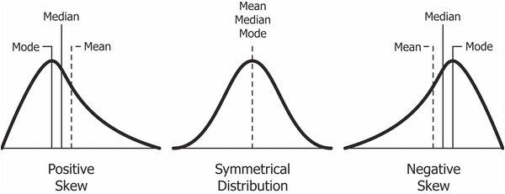
Properties of Arithmetic Mean
Mean is most popular measure of central tendency since it is based on all observations.
It is highly affected by extreme values in the data set. Hence it is not best average to use for describing or summarizing a set of data that has extreme values since it presents a distorted representation of what the data are conveying in such case.
Mean is only applicable to ratio or interval scale data. Only numerical data has its mean.
Further mean can’t be computed accurately in case of open-ended classes.
Mean is biased if distribution is skewed

Slide 11
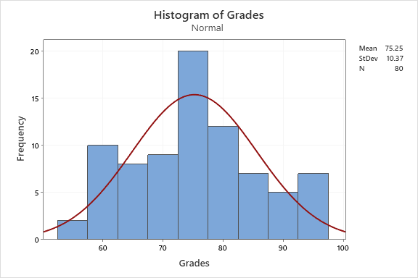
Shape of the distribution of grade of students in Statistics

Slide 12
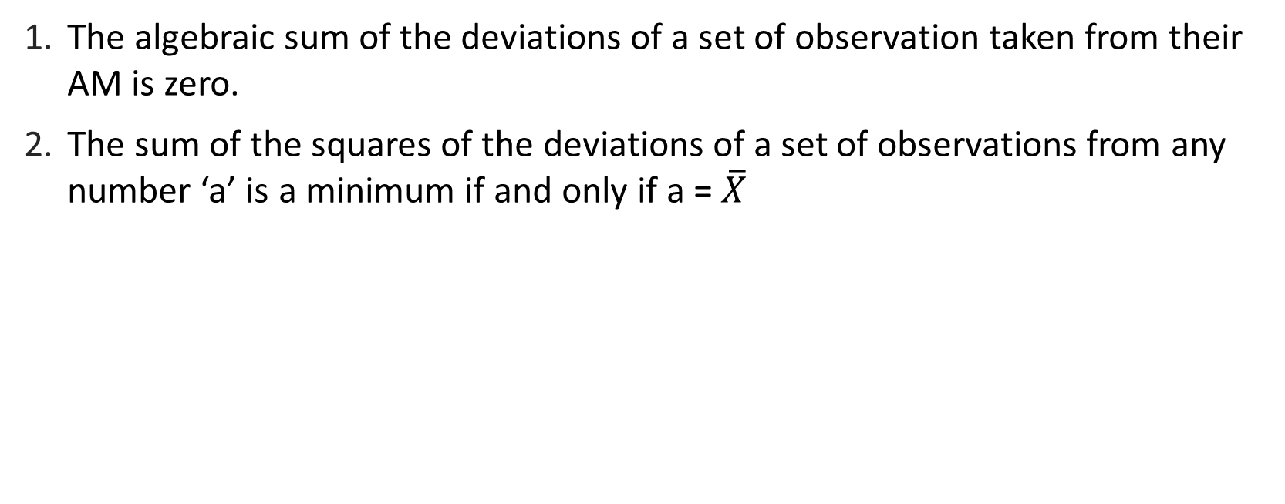
Algebraic properties of AM
The algebraic sum of the deviations of a set of observation taken from their AM is zero.
The sum of the squares of the deviations of a set of observations from any number ‘a’ is a minimum if and only if a = $\overline{X}$

Slide 13
Median
The median is typically defined as the middle measurement in an ordered set of data i.e. there are just as many observations larger than the median as there as smaller. It is a value which divides the whole distribution in two equal halves, one half comprising all the values smaller than median, and other half comprising all the value greater than median.
Notation: M or M_{d} or x̃ “x-tilde” --- Sample median
Individual Data
When the data is given individually, we first arrange the set of data in ascending (or descending) order of magnitude.

Slide 14
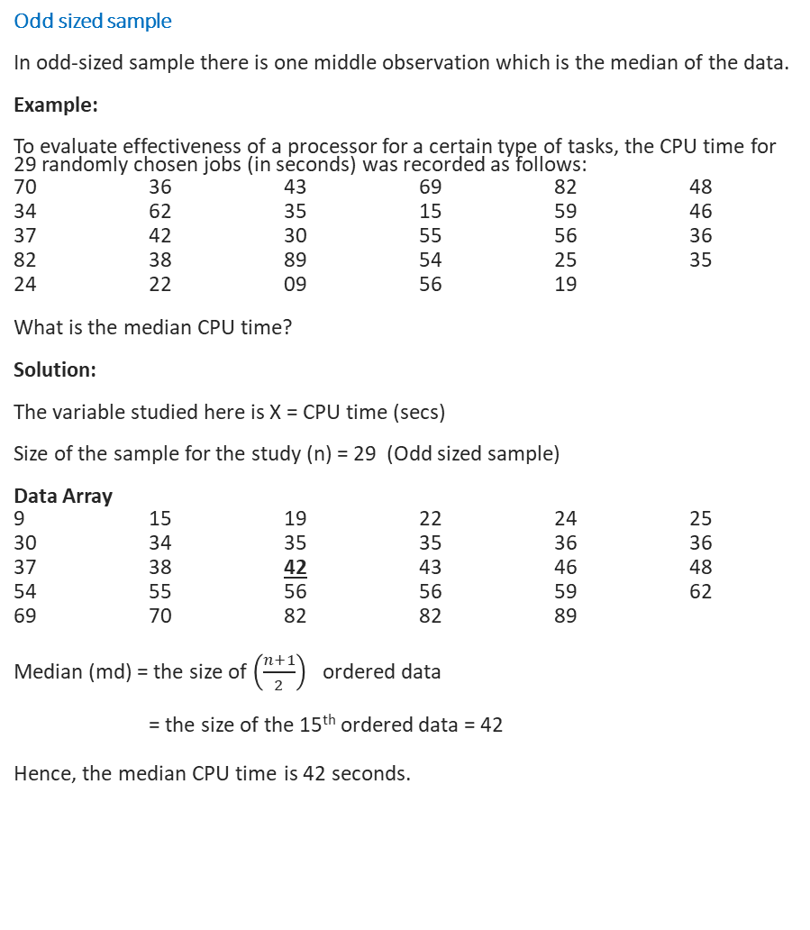
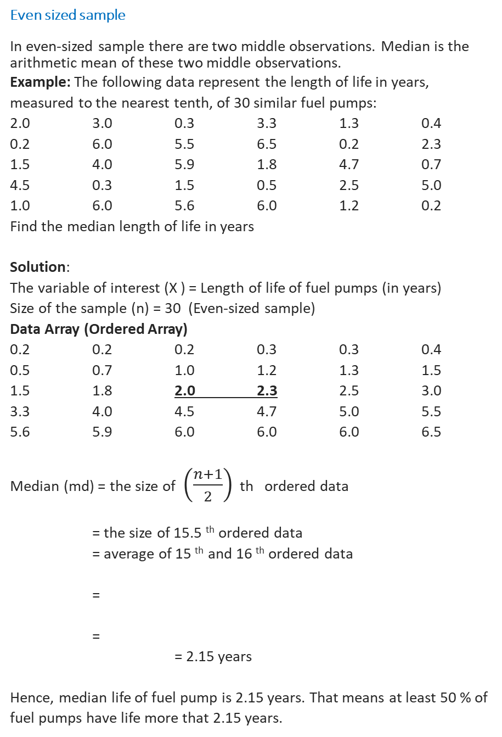
Even sized sample
In even-sized sample there are two middle observations. Median is the arithmetic mean of these two middle observations.
Example: The following data represent the length of life in years, measured to the nearest tenth, of 30 similar fuel pumps:
2.0 3.0 0.3 3.3 1.3 0.4
0.2 6.0 5.5 6.5 0.2 2.3
1.5 4.0 5.9 1.8 4.7 0.7
4.5 0.3 1.5 0.5 2.5 5.0
1.0 6.0 5.6 6.0 1.2 0.2
Find the median length of life in years
Solution:
The variable of interest (X ) = Length of life of fuel pumps (in years)
Size of the sample (n) = 30 (Even-sized sample)
Data Array (Ordered Array)
0.2 0.2 0.2 0.3 0.3 0.4
0.5 0.7 1.0 1.2 1.3 1.5
1.5 1.8 2.0 2.3 2.5 3.0
3.3 4.0 4.5 4.7 5.0 5.5
5.6 5.9 6.0 6.0 6.0 6.5
Median (md) = the size of $\left(\frac{n+1}{2}\right)$ th ordered data
= the size of 15.5 ^{th} ordered data
= average of 15 ^{th} and 16 ^{th} ordered data
=
=
= 2.15 years
Hence, median life of fuel pump is 2.15 years. That means at least 50 % of fuel pumps have life more that 2.15 years.
Odd sized sample
In odd-sized sample there is one middle observation which is the median of the data.
Example:
To evaluate effectiveness of a processor for a certain type of tasks, the CPU time for 29 randomly chosen jobs (in seconds) was recorded as follows:
70 36 43 69 82 48
34 62 35 15 59 46
37 42 30 55 56 36
82 38 89 54 25 35
24 22 09 56 19
What is the median CPU time?
Solution:
The variable studied here is X = CPU time (secs)
Size of the sample for the study (n) = 29 (Odd sized sample)
Data Array
9 15 19 22 24 25
30 34 35 35 36 36
37 38 42 43 46 48
54 55 56 56 59 62
69 70 82 82 89
Median (md) = the size of $\left(\frac{n+1}{2}\right)$ ordered data
= the size of the 15th ordered data = 42
Hence, the median CPU time is 42 seconds.

Slide 15

Computing median in ungrouped frequency distribution
Example:
In a survey of 40 families in a village, the number of children per family was recorded and the following data was obtained.
1 0 3 2 1 5
6 2 2 1 0 3
4 2 1 6 3 2
1 5 3 3 2 4
2 2 3 0 2 1
4 5 3 3 4 4
1 2 4 5
Represent the data in the form of a ungrouped frequency distribution
Compute the median of the distribution
Solution:
Variable (X) = No. of children per family
No. of households surveyed (n) = 40
The frequency distribution is given by
Now, the median is given by
Median (md) = the value of ordered data
= the value of 20.5th ordered data
From table it is clear that from 21st to 28th data its all 3, our interest is 21st data which is 3. Hence, median is 3.
X | 0 | 1 | 2 | 3 | 4 | 5 | 6
f | 3 | 7 | 10 | 8 | 6 | 4 | 2 = 40
C.f. | 3 | 10 | 20 | 28 | 34 | 38 | 40
$${\left(\frac{n+1}{2}\right)}^{th}$$

Slide 16
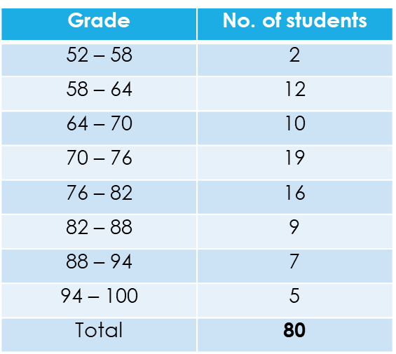
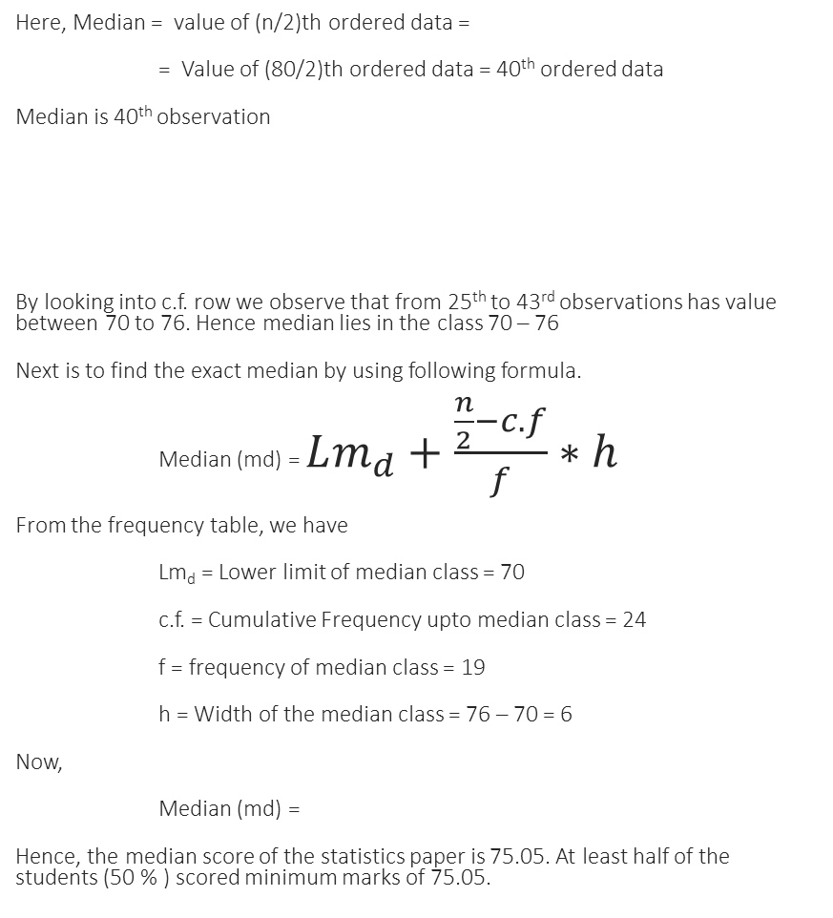

Computing median in grouped frequency distribution
Here, Median = value of (n/2)th ordered data =
= Value of (80/2)th ordered data = 40th ordered data
Median is 40th observation
By looking into c.f. row we observe that from 25th to 43rd observations has value between 70 to 76. Hence median lies in the class 70 – 76
Next is to find the exact median by using following formula.
Median (md) = $Lm_{d}+\frac{\frac{n}{2}−c.f}{f}∗h$
From the frequency table, we have
Lm_{d} = Lower limit of median class = 70
c.f. = Cumulative Frequency upto median class = 24
f = frequency of median class = 19
h = Width of the median class = 76 – 70 = 6
Now,
Median (md) =
Hence, the median score of the statistics paper is 75.05. At least half of the students (50 % ) scored minimum marks of 75.05.
The grades of students in statistics
What is the median grade of students ?
Solution:
Variable (X) = Grades of students in statistics
Sample size (n) = 80
First we find the class groupings where the median falls.
X | 52-58 | 58-64 | 64-70 | 70-76 | 76-82 | 82-88 | 88-94 | 94-100
f | 2 | 12 | 10 | 19 | 16 | 9 | 7 | 5
cf | 2 | 14 | 24 | 43 | 59 | 68 | 75 | 80
$$70+\frac{40−24}{19}∗6=75.05$$

Slide 17
Properties of median
Median express less information than does the mean, for it does not take into account the actual value of each measurement, but only considers the rank of each measurement.
It is resistant statistics i.e. extremely high or extremely low measurements will not affect the median. So when we deal with skewed population, we may prefer the median to the mean to express the central tendency.
Median can be determined not only for interval and ratio scale data, but also for data on ordinal scale.
For a symmetrical distribution median = mean, hence it is also an unbiased estimator of population mean (μ). If the frequency distribution is asymmetrical median ≠ mean and it is a poor estimate of the population mean.

Slide 18
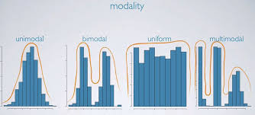
Mode of the distribution
Modality
Ex 1: Data set: 2, 4, 6, 7, 11, 12
There is no mode
Ex 2: Data set: 1,1, 3, 3, 3, 3, 5, 5, 5, 5, 5, 5, 6, 6, 7
There is unique mode and that is 5 because there is only one peak and value 5 repeats max. no. of times i.e. 6 (unimodal distribution)
The mode is the value in a set of data that repeats maximum number of time (or that appear most frequently).
Mode is the most popular value in the data set and considers neither the other values nor their frequencies.
Mode is not necessarily single valued. Two or more values may be observed with equal frequency. That is mode is not always unique
Mode is not always defined.
A distribution is said to be bimodal if there is two popular values in the distribution.
A distribution having more than one mode is called multimodal distribution.

Slide 19


Ex 3: Data set: 1, 1, 3, 3, 3, 3, 4, 4, 5, 5, 5, 5, 5, 5, 6, 6, 6, 7, 7, 9
This is the case of bimodal distribution. There are two clear peaks. Hence, the minor mode is 3 and major mode is 5.
Ex 4 : Consider the following frequency distribution
Here, the maximum frequency is 12 and the frequencies are in regular order. Hence, mode is unique and it is 2. It means that typically a household has 2 siblings.
Computing mode in grouped frequency distribution
Ex 5: Considers the following grouped frequency distribution
In this case, the frequencies are in regular fashion, and maximum frequency occurs in the class grouping 70 – 76 and which is 19. Hence mode lies in the class 70 – 76. There is a unique mode for this distribution (unimodal distribution) and the exact value of mode is given by,
Mode (m_{o}) =
Here,
f_{max} = maximum frequency = 19
f₁ = frequency of the class preceding to modal class = 12
f₂ = frequency of the class succeeding to the modal class = 16
d₁ = fmax –f1 = 19 – 12 = 7
d₂ = fmax – f2 = 19 – 16 = 3
h = frequency of the modal class = 6
Lm_{o} = Lower limit of the modal class = 70
Now, the mode is calculated as follows,
Mode (m_{o}) =
Grades | 52 - 58 | 58 - 64 | 64 - 70 | 70 - 76 | 76 - 82 | 82 - 88 | 88 - 94 | 94 - 100
No. of students | 2 | 10 | 12 | 19 | 16 | 9 | 7 | 5
$$Lm_{0}+\frac{d_{1}}{d_{1}+d_{2}}∗h$$
No. of siblings | 0 | 1 | 2 | 3 | 4 | 5 | 6 | 7
Frequency | 2 | 7 | 12 | 5 | 4 | 2 | 1 | 0
$$70+\frac{7}{7+3}∗6=74.2$$

Slide 20
Properties of mode
Mode is least affected by skewness.
Since mode is the most frequent value of the data set to be modal value, it is not affected by extreme values.
We can use the mode no matter how large, how small, or how spread out the values in the data set happens to be.
Mode is more affected by sampling and grouping than mean and median.
Mode is suitable for variable measured in nominal scale data. But can be used for data on ordinal, interval and ratio scale.

Slide 21
Summary
Mean
When the data is approximately normally distributed.
When the data does not have extreme outliers that could significantly skew the results.
When working with interval or ratio data.
Median
When the data set has outliers or is skewed.
When the distribution of the data is not symmetric.
When working with ordinal, interval, or ratio data.
Mode
When identifying the most common value in a data set.
When looking for patterns or clusters in the data.
When dealing with categorical data.
When dealing with count data

